Slide 1
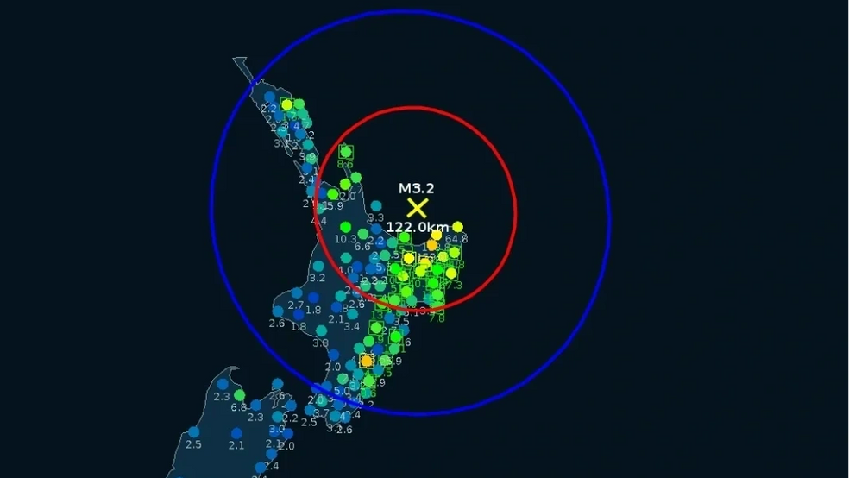
GlobalQuake
A real time earthquake monitoring and early warning system

Slide 2
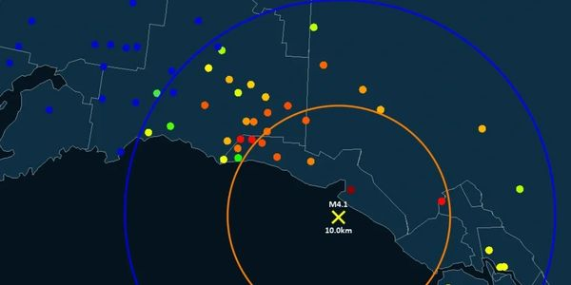
Table of contents
How does it work?
Key features
GlobalQuake in action
Bonus

Slide 3
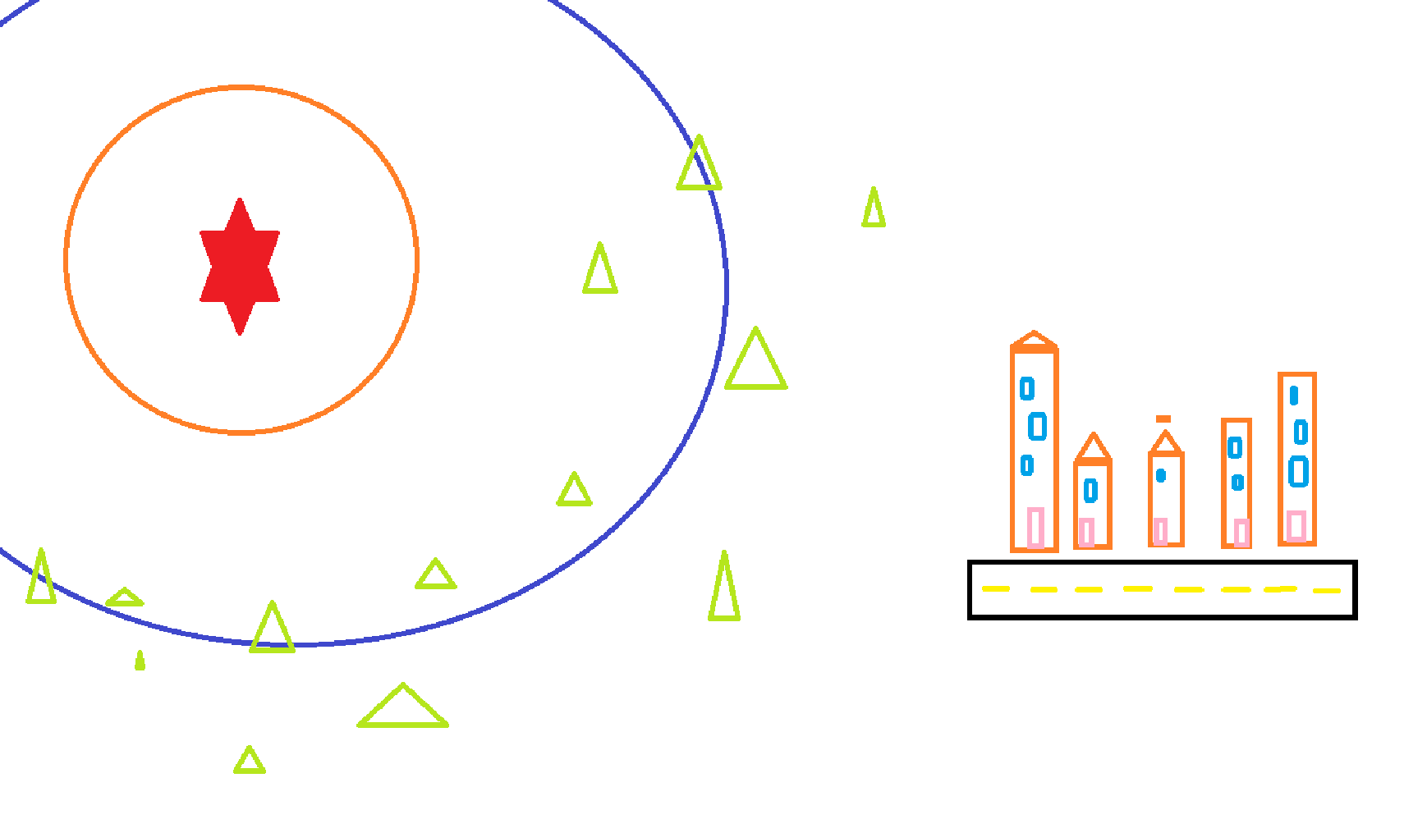
Introduction to earthquake detection

Slide 4
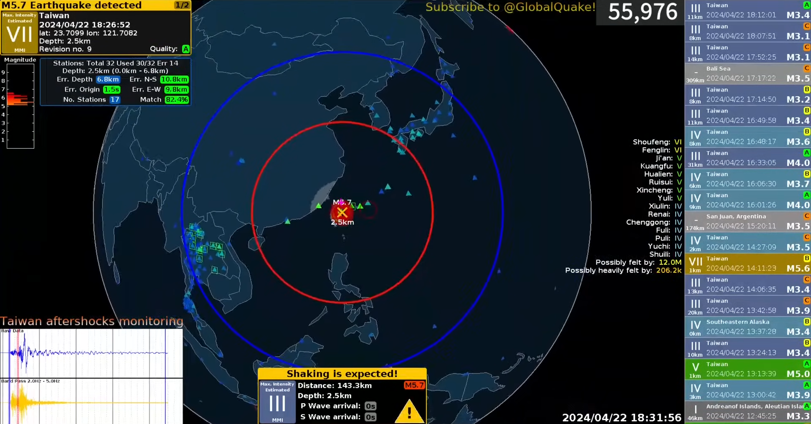

Slide 9
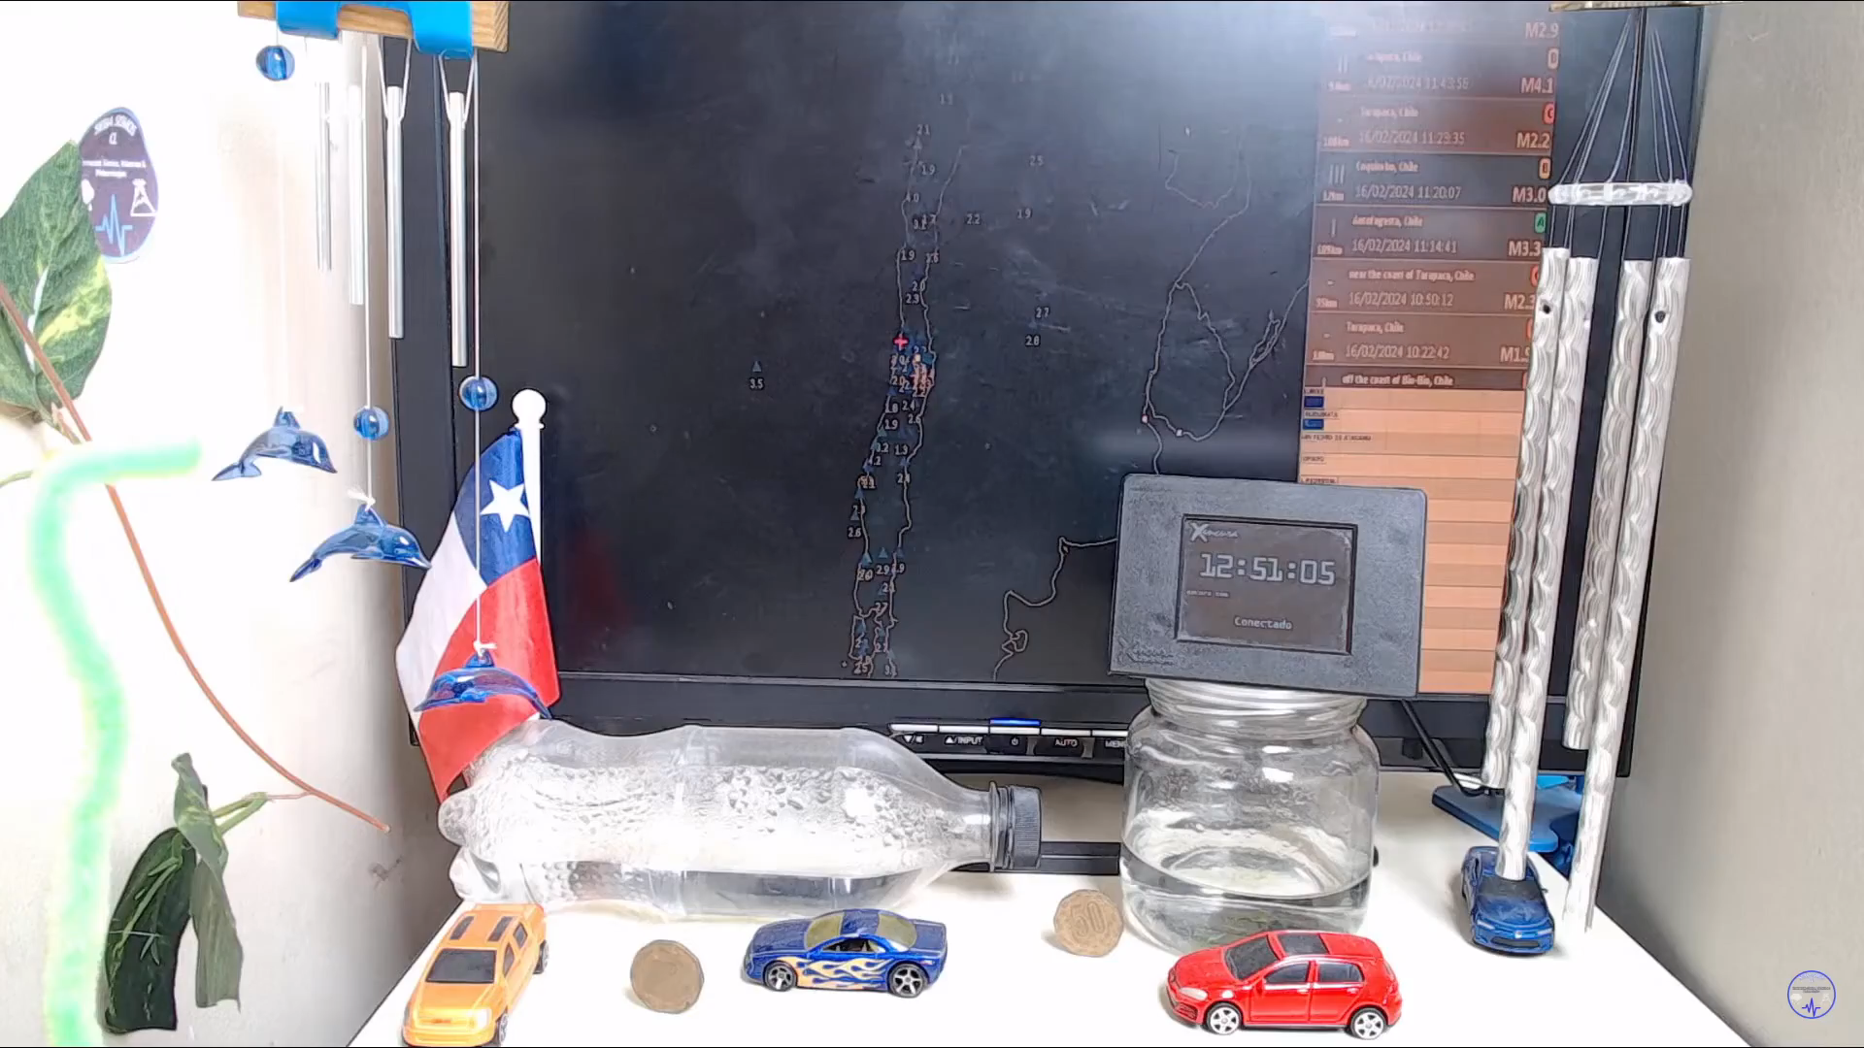

Slide 10
Demo video
https://www.youtube.com/watch?v=yQGz1fUITAs

Slide 11
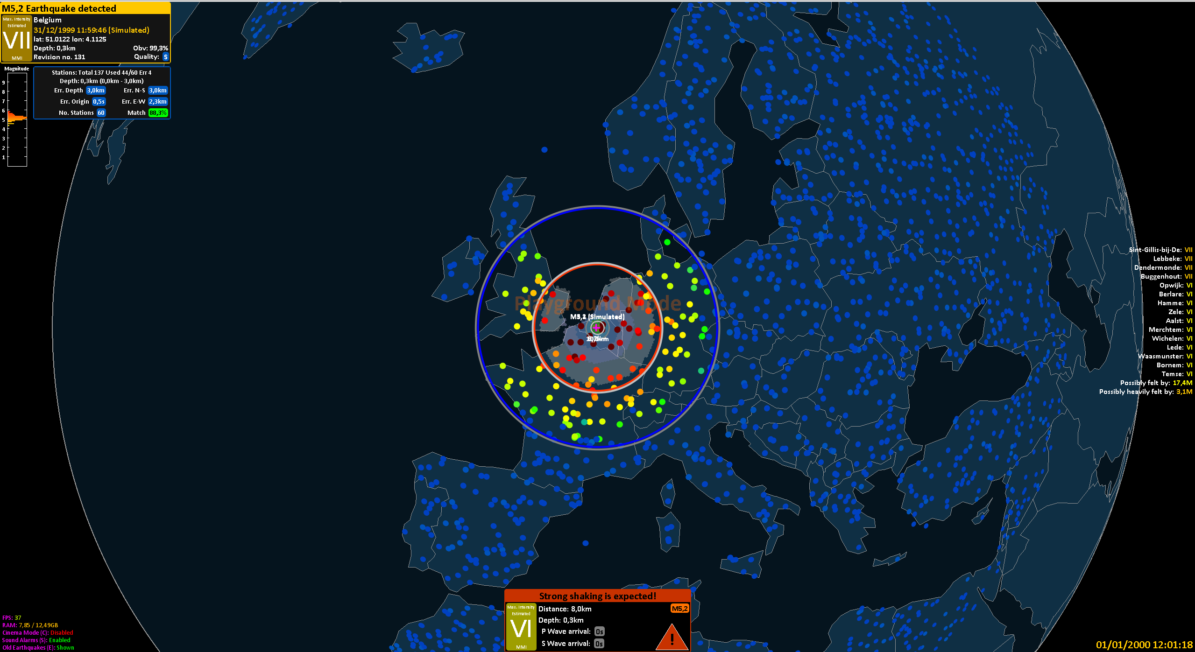
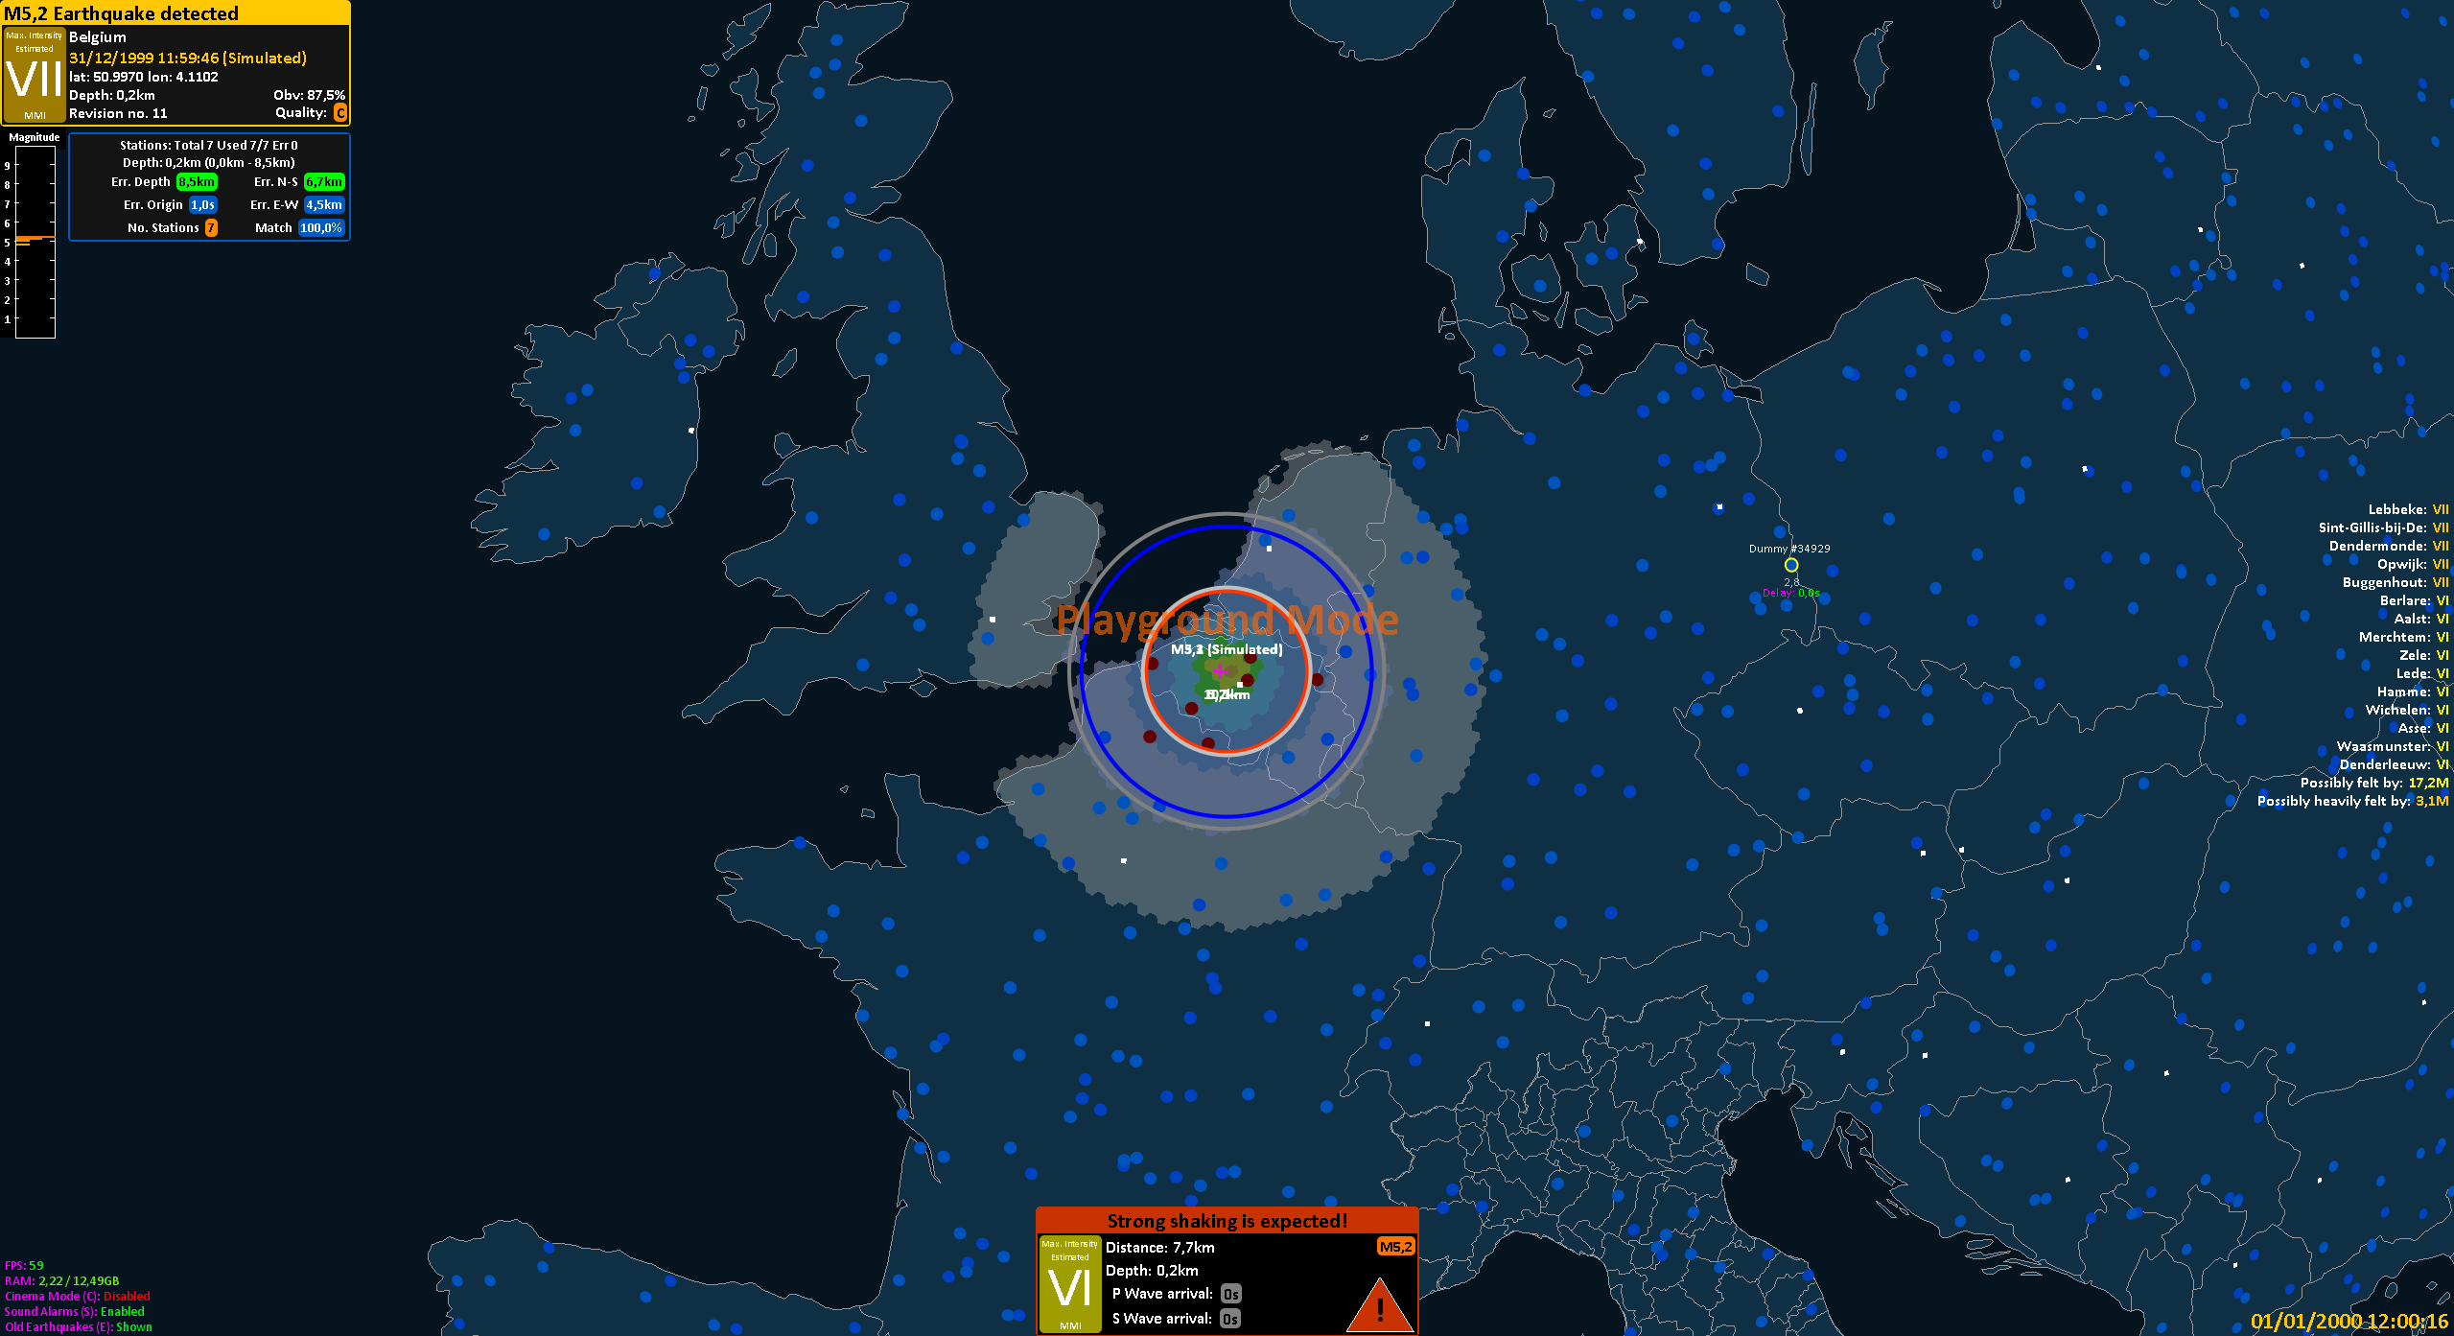

Slide 12
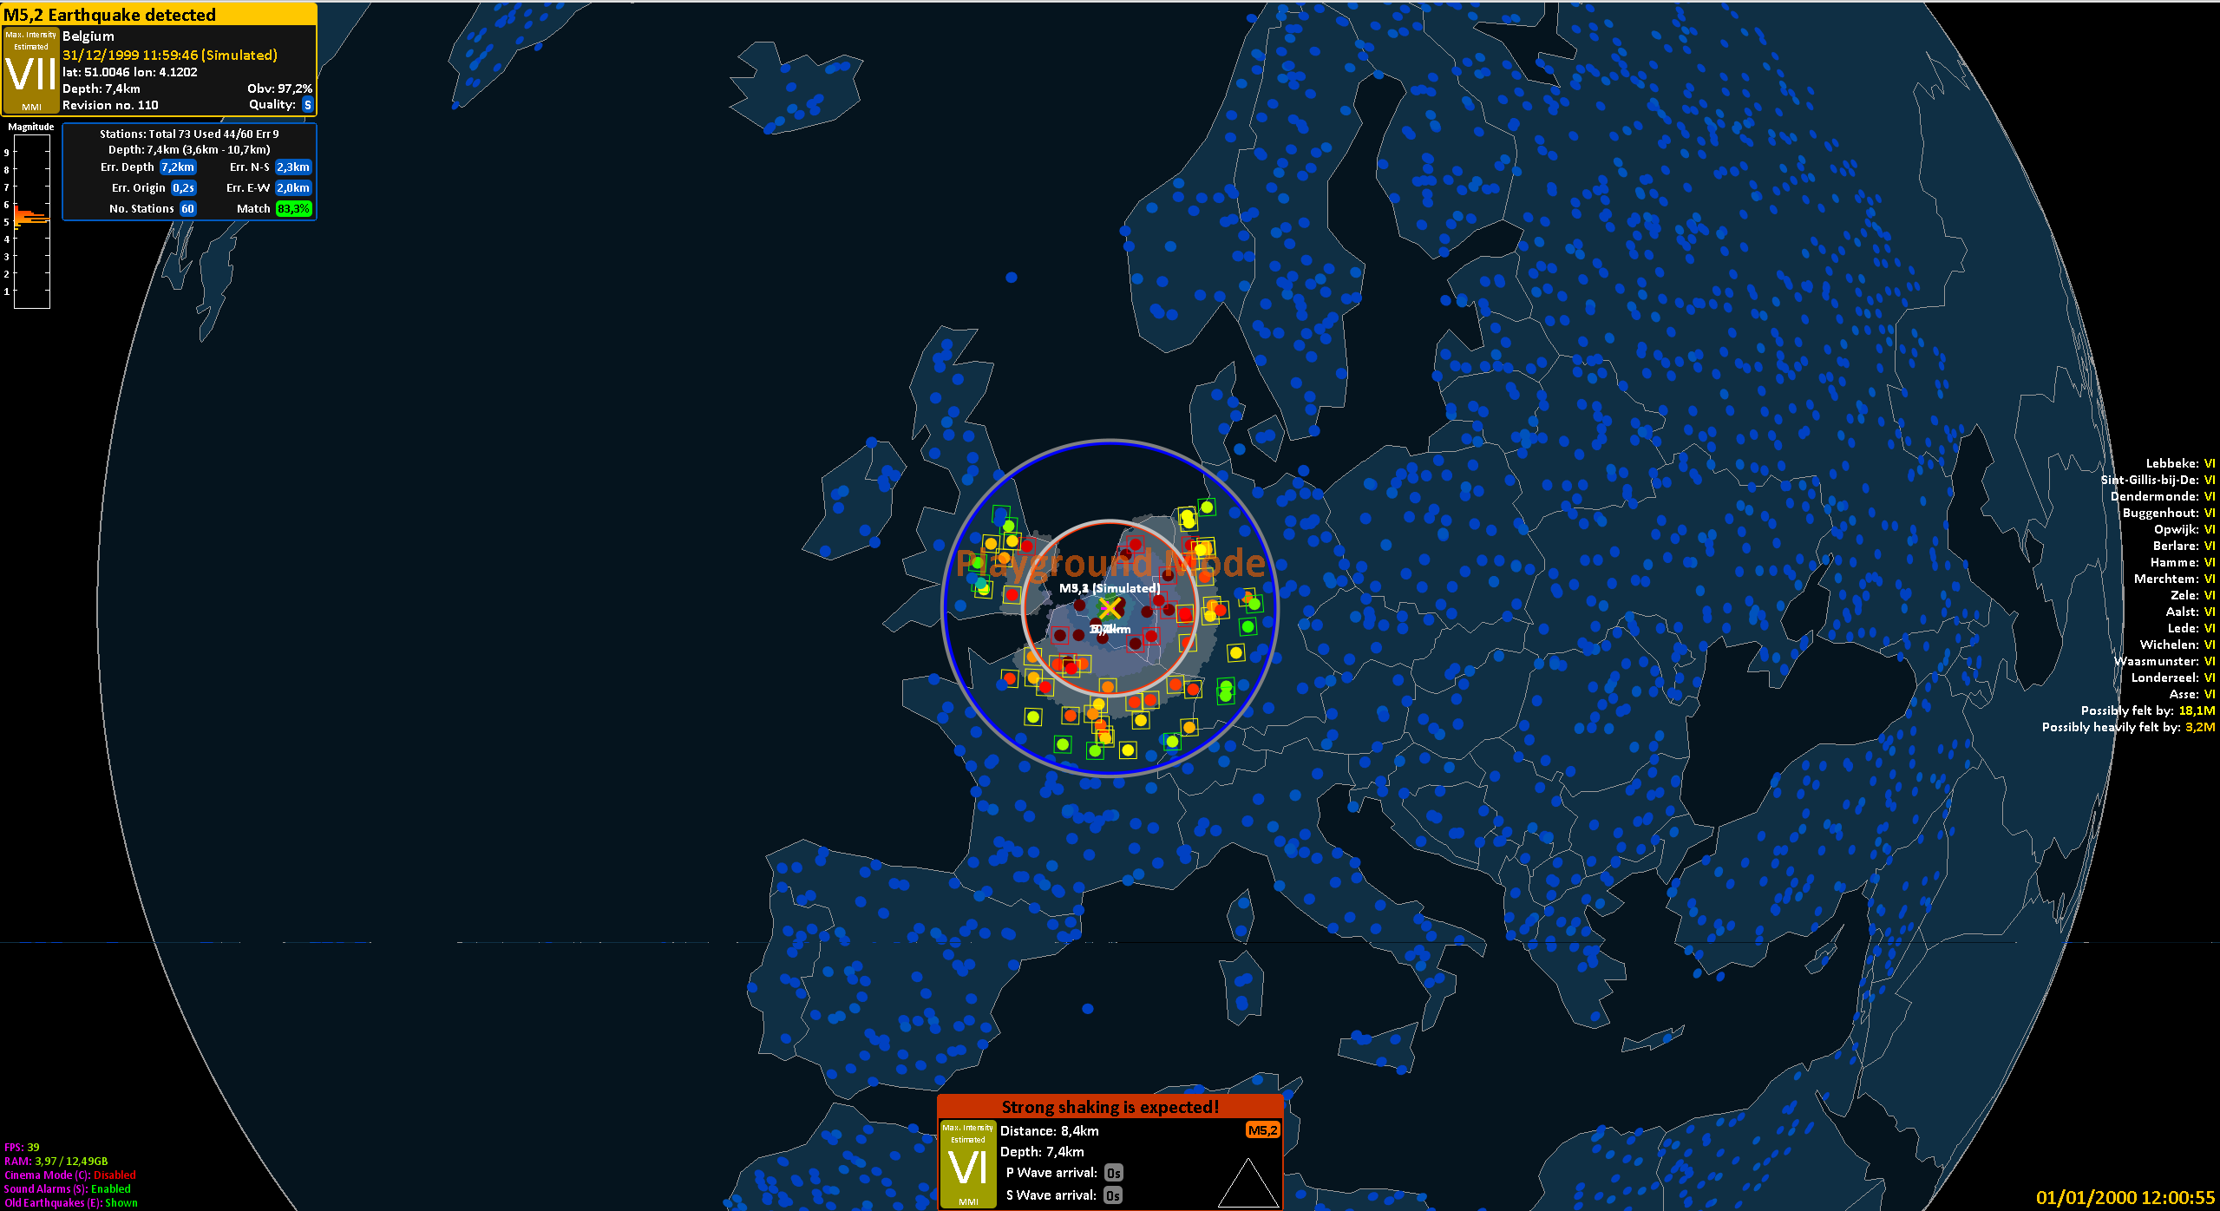

Slide 13


Slide 14
